Slide 1
Accelerating Multipattern Matching on Compressed HTTP Traffic
Published in : IEEE/ACM TRANSACTIONS ON NETWORKING, VOL. 20, NO. 3, JUNE 2012
Authors : Bremler-Barr, A. ; Interdiscipl. Center, Efi Arazi Sch. of Comput. Sci., Herzlia, Israel ; Koral, Y.

Slide 2
Introduction
At the heart of almost every modern security tool is a pattern-matching algorithm.
Multipattern matching on compressed traffic requires two time-consuming phases, namely traffic decompression and pattern matching.
Most current security tools either ignore scanning compressed traffic or disable the option for compressed traffic.

Slide 3
LZ77 Algorithm
The LZ77 algorithm compresses data that has already appeared in the past (a sliding window of the last 32 kB of data) by encoding it with a pair (distance, length), where distance is a number in [1, 32768] length is a number in [3, 258]

Slide 4
Examples
abcdefabcd abcdef(6, 4)
<title>Test</title> <title>Test</[6;12]
Blah blah blah blah blah! Blah b[D=5, L=18]!

Slide 5
Aho–Corasick (AC) algorithm
The basic AC algorithm constructs a deterministic finite automaton (DFA) for detecting all occurrences of given patterns by processing the input in a single pass.

Slide 6
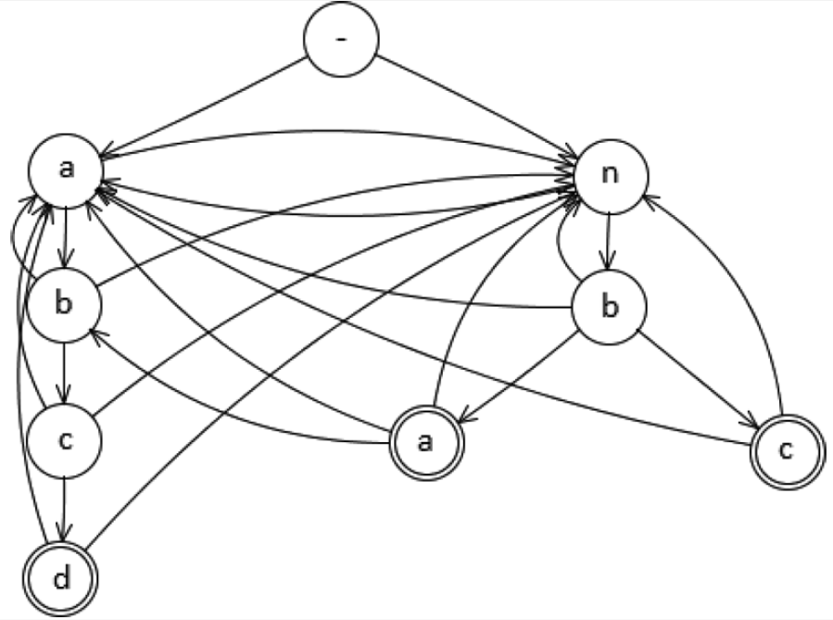
AC DFA for patterns “abcd”, “nba”, “nbc”

Slide 7
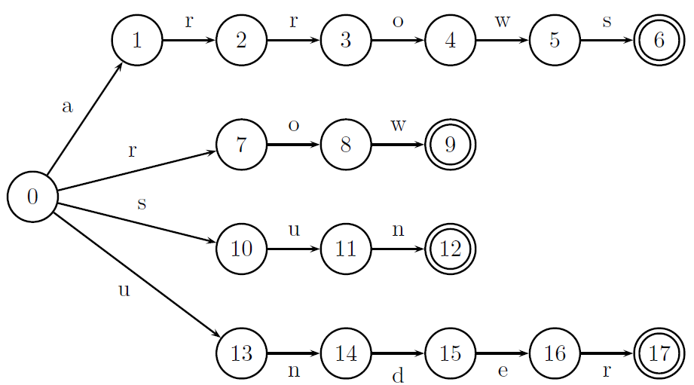
AC DFA for patterns “arrows”, “row”, “sun”, “under”

Slide 8
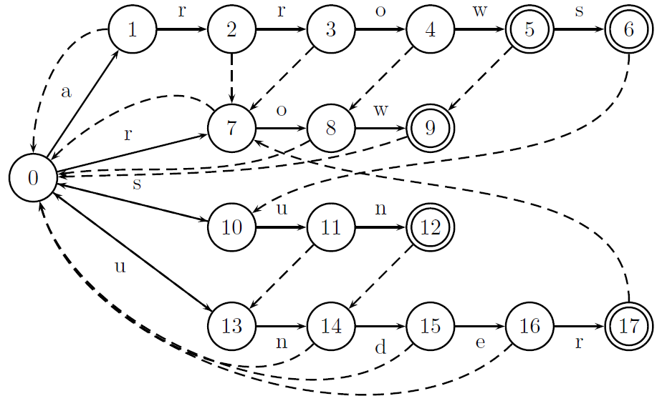
Failure Function

Slide 9

Example: arrowsunderows

Slide 10
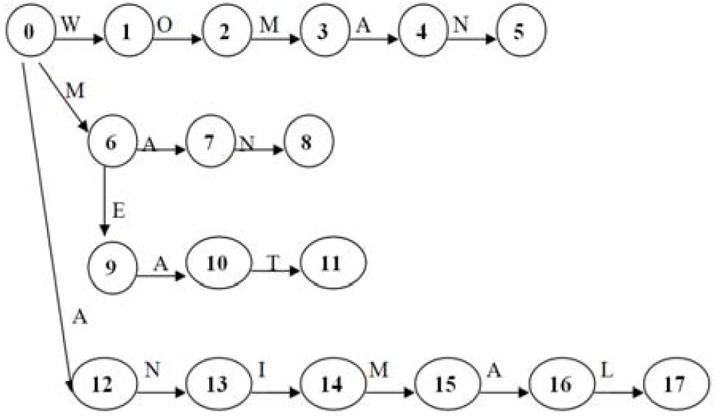
AC DFA for patterns “WOMAN”, “MAN”, “MEAT”, “ANIMAL”

Slide 11
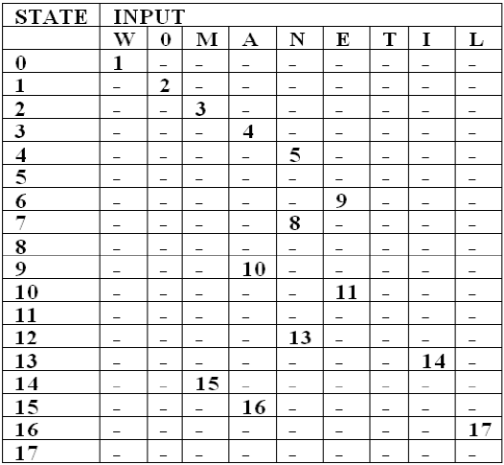
Transition Table of Automata

Slide 12
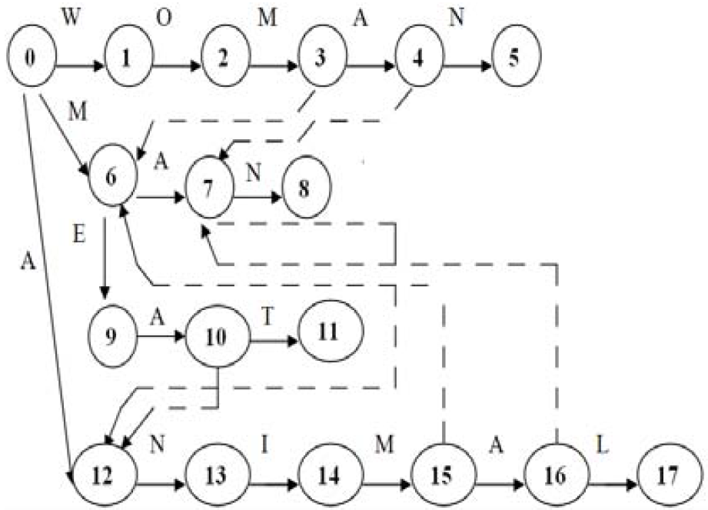
Failure Function

Slide 13
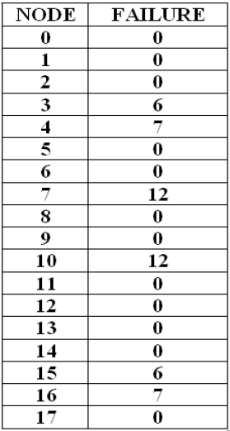
Failure Function Table

Slide 14
The AC algorithm requires significantly more time than decompression.
Decompression is based on consecutive memory reading from the sliding window, hence it has low read-per-byte cost.
The AC algorithm employs a very large DFA that is accessed with random memory reads, which typically does not fit in cache, thus requiring main memory accesses.

Slide 15
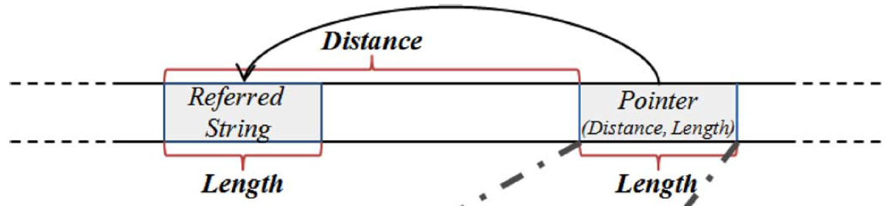
Aho–Corasick-based algorithm on Compressed HTTP (ACCH)
The basic observation is that if the referred string does not completely contain matched patterns, then the pointer also contains none.
The algorithm may skip scanning bytes in the uncompressed data where the pointer occurs.

Slide 16
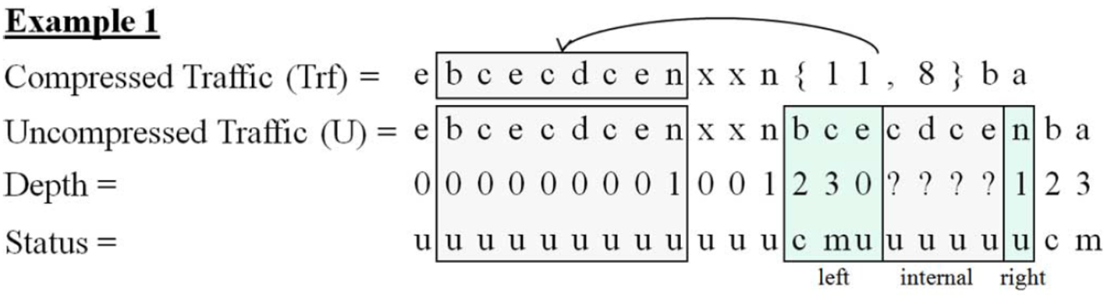
Three Special Cases
The pattern starts prior to the pointer, and only its suffix is in the pointer.
The pointer contains a pattern prefix, and its remaining bytes occur after.

Slide 17
In order to detect those patterns, we need to scan a few bytes within the pointer starting and ending points denoted by pointer left boundary and right boundary scan areas, respectively.
If no matches occurred within the referred string, the algorithm skips the remaining bytes between the pointer boundaries denoted by internal area.

Slide 18
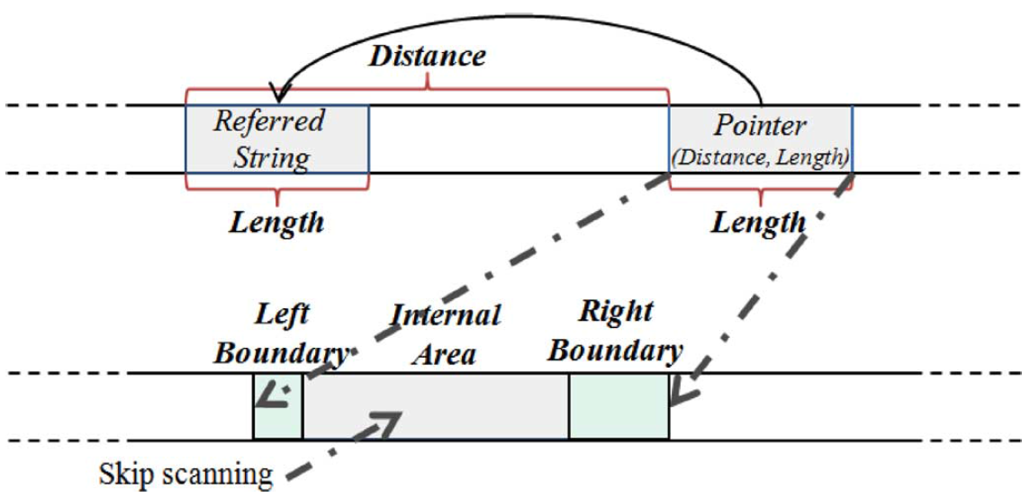

Slide 19
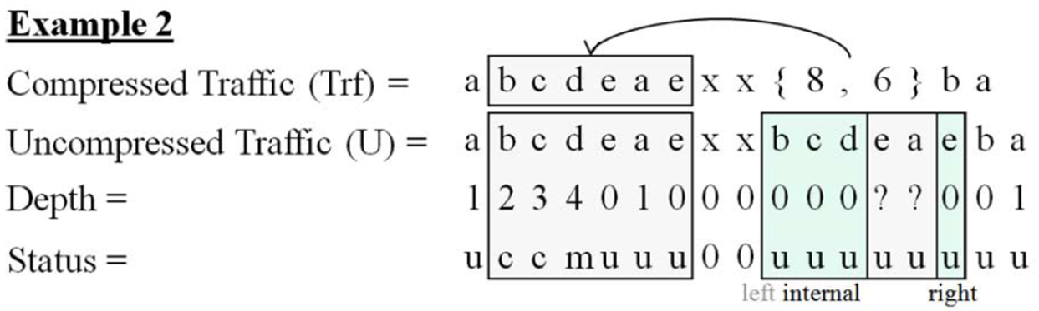
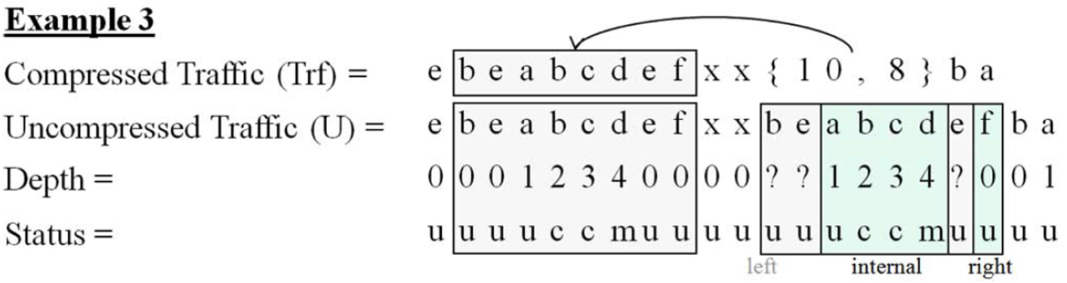
A pattern ends within the referred string.

Slide 20
Left Boundary (First Case)
The algorithm should continue scanning the pointer bytes (in the uncompressed data) as long as the number of bytes scanned within the pointer is smaller than the current DFA state’s depth.

Slide 21


Slide 22
Right Boundary (Second Case)
If the depth of the corresponding byte is below some constant CDepth, this byte is marked with a status of Uncheck; otherwise the byte is marked Check.
The algorithm locates the last occurrence of an Uncheck status position within the referred string. Let unchkPos be the corresponding position within the pointer. The scan is resumed from unchkPos – CDepth + 2 bytes prior to the pointer end, and the DFA state is set to start state.

Slide 23
Internal Area (Third Case)
A byte with a Match status means that a pattern (or more) ends at its location. Let matchPos be the position within the pointer, corresponding to the position of the Match status within the referred string. Using the status information, we could detect whether an entire pattern was referred to by the pointer by scanning a few bytes prior to the matchPos in the same manner as in the case of the right boundary.

Slide 24
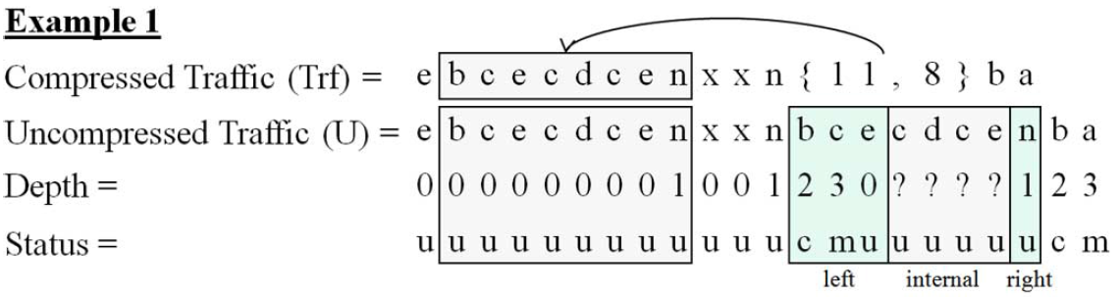



Slide 25
Experimental Results
Two data sources: traffic that was captured by a corporate firewall for 15 min and a list of the most popular Web pages taken from the Alexa Web site.
Two signature data sets: one of ModSecurity, an open-source Web application firewall, and the other of Snort, an open-source network intrusion prevention and detection system.

Slide 26
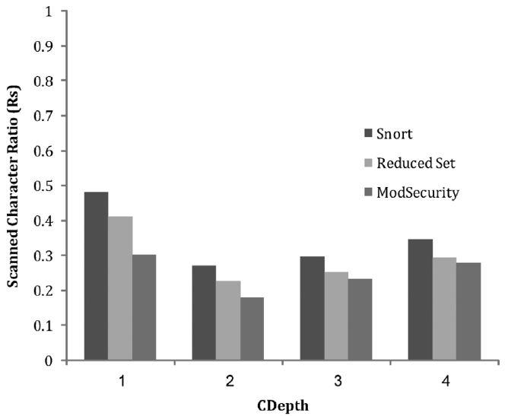

Slide 27
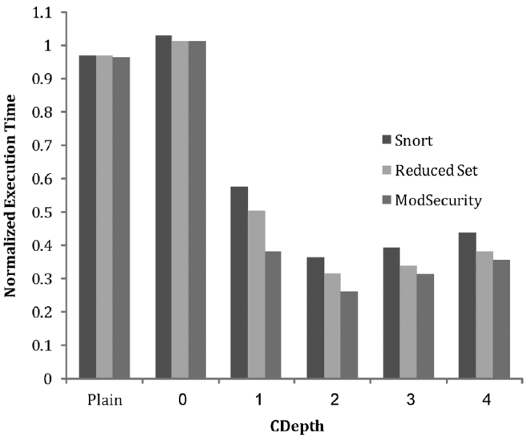

Slide 28
Conclusion
Surprisingly, it is faster to do pattern matching on compressed data, with the penalty of decompression, than doing pattern matching on uncompressed traffic.

Slide 29
Reference
Dictionary Matching Automata The Aho-Corasick Algorithm
Importance of Aho-Corasick String Matching Algorithm in Real World Applications
演算法筆記- String Matching

